Slide 1
Customer Reviews Analysis – British Airways
Understanding Customer Feedback for Improvement.

Slide 2
INTRODUCTION
In a world where customer satisfaction is paramount, understanding the factors that drive positive recommendations is crucial for the success of any airline.
Today, we delve into key insights derived from customer feedback, focusing on the correlations between aircraft, type of traveler, seat type, route, date flown and the various ratings on seat comfort, cabin staff service, food and beverages, inflight entertainment, ground service, wifi and connectivity, value for money and recommendation. With a spotlight on the impact of high-quality Inflight entertainment and cabin service against other variables on recommendations.
As we explore these findings, we will unravel strategies to enhance British Airways’ services, elevate customer satisfaction, and attract more passengers for sustained business growth.
Furthermore, we would explore the unexpected revelation that the date flown holds minimal influence on customer recommendations during peak flight months.
Join us on this journey to unlock the secrets to a more successful and customer-centric British Airways.

Slide 3
METHODOLOGY OVERVIEW
Analytical Approach :
Comprehensive examination of customer feedback using tableau.
Variables : Cabin staff services(CS), Seat comfort(SC),Inflight Entertainment(IE),Ground services(GS),Food and Beverages(FB),Wifi and Connectivity and Value for money(VFM) systematically analyzed.
Identification of relationships between variables for meaningful insights.
Plotting Variables :
Cabin staff service versus seat comfort, inflight entertainment, ground services, food and beverages and wifi and connectivity.
Visual representation aids in identifying trends and anomalies.

Slide 4
Aircraft/Cabin staff services/Inflight Entertainment Filtering :
Specificity ensured by filtering results by aircraft, cabin staff services and Inflight Entertainment.
CS Analysis: 9 Aircraft marked ‘no’ in CS vs SC, 6 Aircraft in CS vs IE, 8 in CS vs GS, 10 in CS vs FB, 1 in CS vs WF.
IE Analysis : 2 Aircraft marked ‘no’ in IE vs FB, 4 Aircraft in IE vs GS, 8 in IE vs SC, 2 in IE vs VFM, 2 in IE vs WF.
Number of Aircraft Involved:
Comprehensive analysis based on feedback from 200 aircrafts
This methodical approach lays the groundwork for unraveling insightful observations and providing targeted recommendations to enhance the overall customer experience with British Airways.

Slide 5
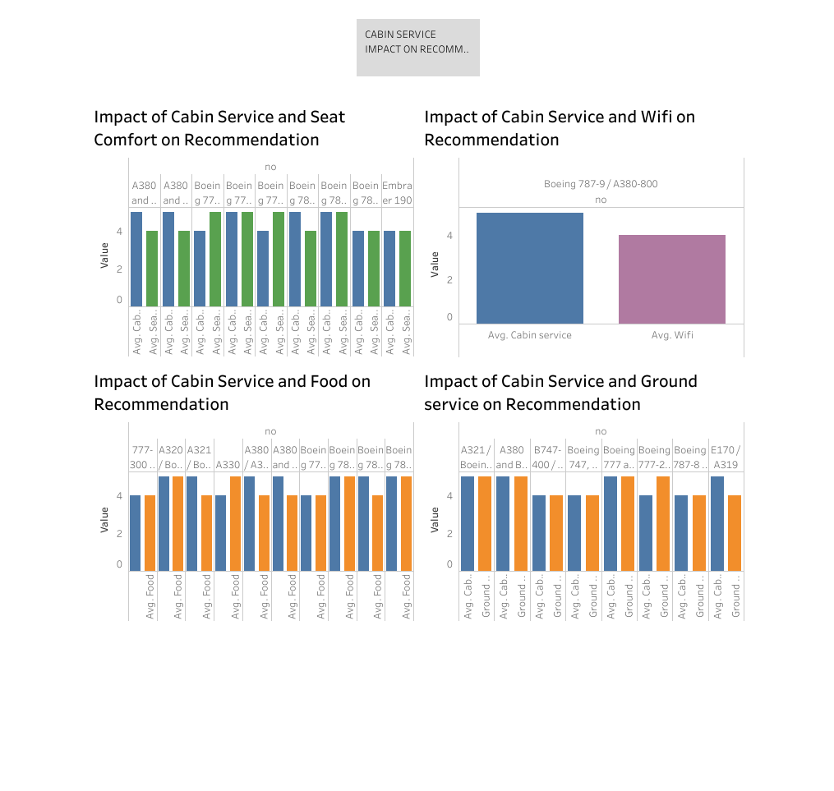
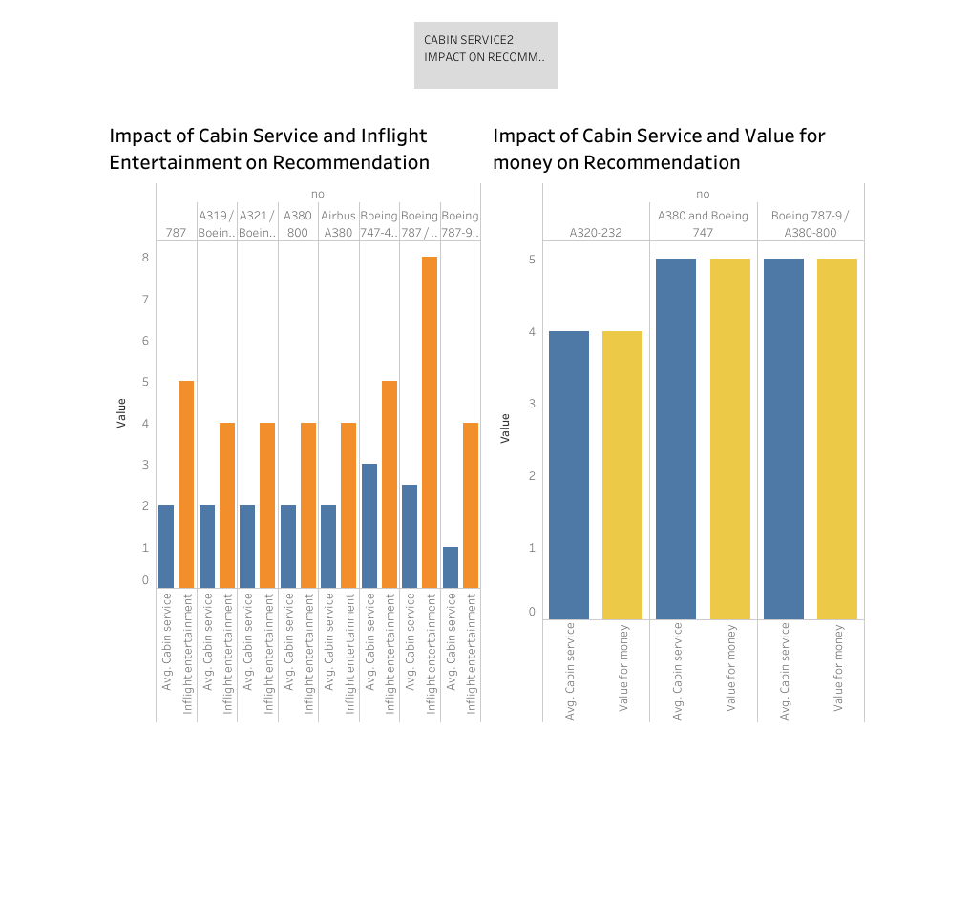
CABIN STAFF SERVICE ANALYSIS :

Slide 6
CABIN STAFF SERVICE(CS) ANALYSIS:
Key Insights:
A collective evaluation of Cabin staff service(CS) against SC, IE, GS, FB, and WF provides a holistic view of passenger satisfaction.
Customers indicated dissatisfaction with seat comfort in 9 aircrafts, signaling an opportunity to enhance this crucial aspect of the cabin staff service.
Conclusive Induction:
Cabin staff service plays an important role in shaping the overall passenger experience.
Addressing seat comfort concerns and aligning inflight entertainment, ground service, food and beverages, and wifi and connectivity with exceptional cabin staff service is paramount.
Recommendations:
Prioritize improvements in seat comfort to align with passenger expectations.
Integrate customer feedback to refine inflight entertainment, ground service, food offerings, and wifi connectivity for a cohesive cabin staff service experience

Slide 7
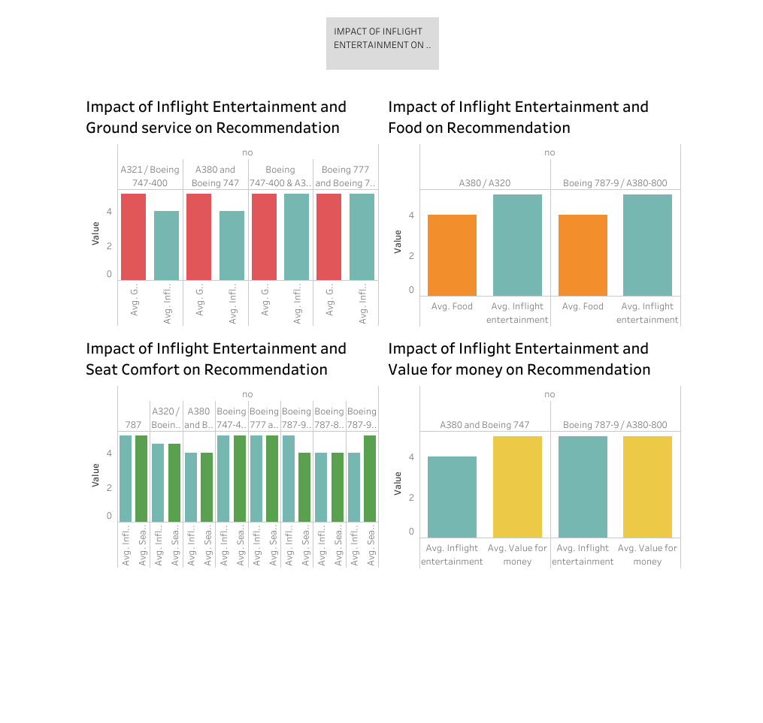
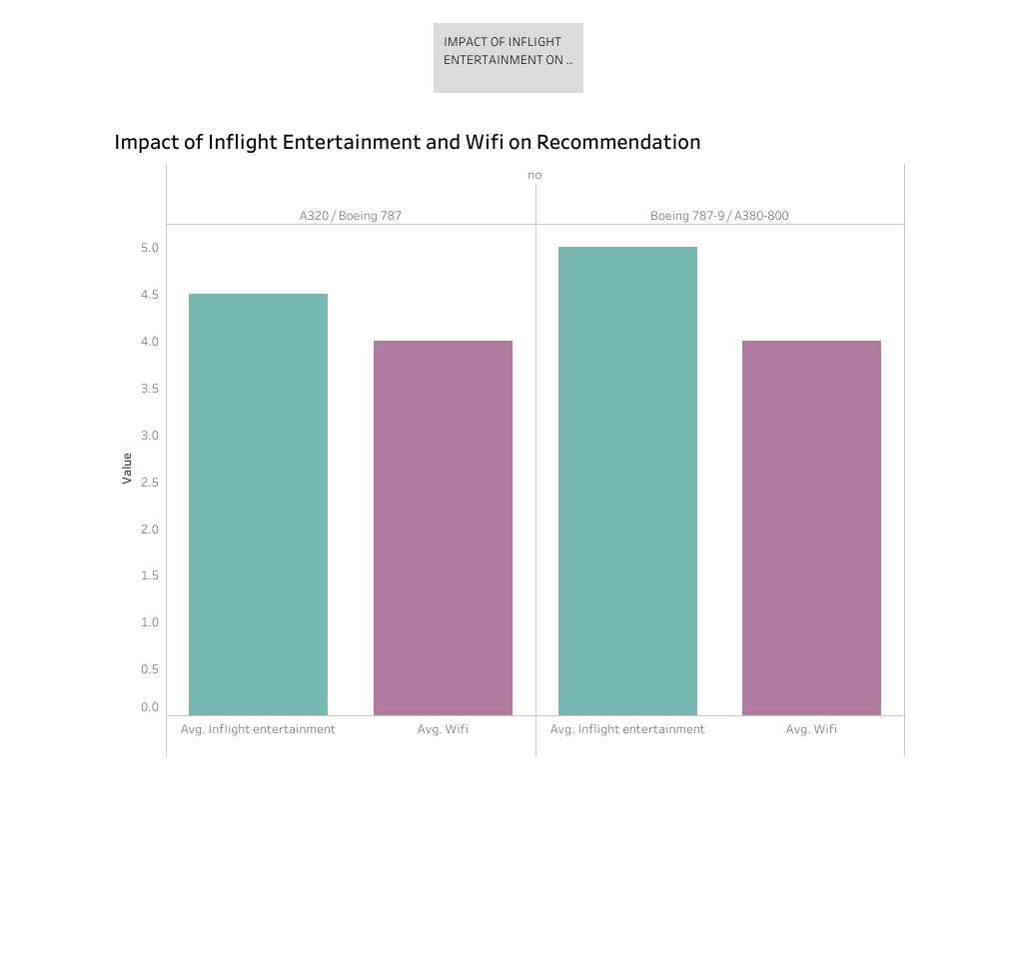
INFLIGHT ENTERTAINMENT ANALYSIS :

Slide 8
INFLIGHT ENTERTAINMENT ANALYSIS:
Key Findings:
Across the analysis of IE against FB, GS, SC, VFM, and WF, critical insights emerged from a diverse set of aircraft experiences.
Notably, 8 aircraft signaled areas for improvement in IE vs SC, indicating a noteworthy aspect of passenger satisfaction.
Central Induction :
Inflight entertainment plays a pivotal role in shaping the passenger experience .
The correlation with seat comfort suggests an interconnected dynamic between entertainment offerings and overall comfort.
Strategic Recommendations :
Address seat comfort concerns in tandem with inflight entertainment enhancements.
Leverage insights to refine ground service, food and beverages, value for money, and Wifi connectivity, ensuring a well-rounded entertainment experience.
By strategically aligning inflight entertainment improvements with broader service enhancements, British Airways can create a compelling and cohesive experience that resonates positively with passengers.

Slide 9
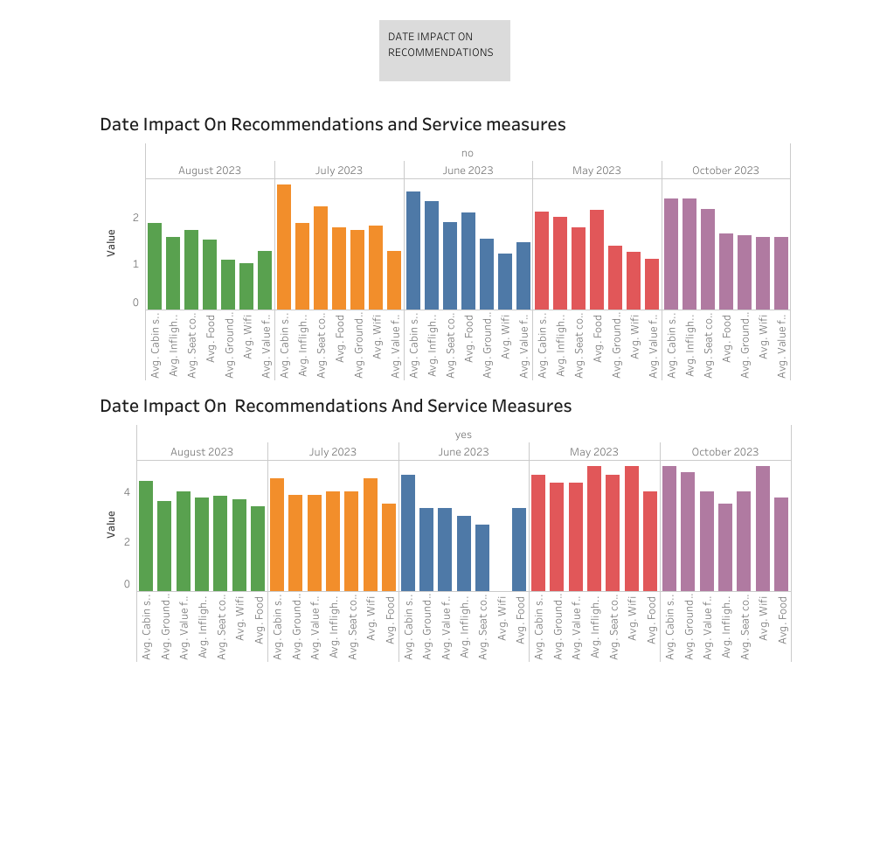
DATE FLOWN IMPACT ON RECOMMENDATIONS :

Slide 10
DATE IMPACT ANALYSIS :
Timeframe Assessment:
Scrutinizing customer recommendations across peak flight periods (May, June, July, August, October) revealed a consistent trend.
Surprisingly, the date flown had minimal discernible impact on customers’ likelihood to recommend the airline.
Key Insights:
Regardless of peak travel periods, customer recommendations exhibited stability, indicating a robust and consistent service standard.
The absence of significant fluctuations in recommendations suggests that British Airways maintains a commendable level of service quality across diverse temporal scenarios.
Strategic Considerations :
While seasonal factors can influence various aspects of travel, the airline’s ability to maintain consistent recommendations underscores the strength of its service delivery.
Emphasizing this temporal neutrality can be leveraged in marketing efforts, highlighting British Airways’ commitment to reliability and quality service year-round.

Slide 11
MEANINGFUL INSIGHTS :
Cabin Service(CS) :
Insights : Seat comfort emerged as consistent concern across 200 aircraft, warranting strategic improvements.
Patterns : The interconnected dynamics of cabin staff service with IE, GS,FB, and WF highlight the need for a cohesive approach to enhance overall satisfaction.
Areas for Improvement : Targeted enhancements in seat comfort and alignments in related services are pivotal.

Slide 12
Inflight Entertainment(IE) :
Insights: Across diverse aircraft, 8 signaled areas for improvement in IE vs SC, emphasizing the importance of entertainment in shaping passenger experiences.
Patterns : The correlation with seat comfort suggests an integrated strategy for Inflight entertainment and Cabin staff service improvements.
Areas for Improvement : Address seat comfort concerns concurrently with refining IE, aligning with broader service enhancements.

Slide 13
Date Flown Analysis :
Insights : Temporal factors displayed minimal influence on customer recommendations, indicating consistent service standards.
Patterns : A temporal-neutral sentiment highlights the airline’s resilience to seasonal variations’
Areas for Improvement : While temporal factors have limited impact, leveraging this consistency in marketing efforts can enhance the airline’s reputation.
Holistic Consideration :
Common Themes : Seat Comfort consistently stands out as an area for refinement, resonating across Cabin staff service, Inflight Entertainment, and date flown analyses.
Strategic Direction : Prioritize seat comfort improvements and integrate strategies that align IE enhancement with broader service improvements.

Slide 14
CONCLUSION
The meticulous analysis of customer feedback has illuminated valuable insights that serve as a compass for British Airways’ journey towards excellence. The recommendations across Cabin Staff Service(CS), Inflight Entertainment(IE) and Date flown showcases an opportunity fro strategic evolution.
Key Takeaways :
Consistent Concern : Seat Comfort emerges as a consistent area for improvement, emphasizing its centrality in the passenger experience.
Interconnected Dynamics :
Recognizing the interconnected dynamics between Cabin Staff Service and Inflight Entertainment, unveils opportunities for holistic enhancements.

Slide 15
Temporal Neutrality : The airline’s resilience across diverse travel periods, positions it as a reliable choice for passengers year-round.
Path-Forward : Embracing the identified recommendations, British Airways is poised to elevate its services. By prioritizing seat comfort, aligning Inflight entertainment improvements strategically, adopting a holistic approach, engaging customers in real-time, leveraging marketing opportunities, and continuous monitoring, the airline charts a course toward sustained excellence .
As we navigate this path, the commitment to delivering exceptional service remains unwavering. Through strategic evolution and customer-centric initiatives, British Airways is well Positioned to redefine the flying experience and reinforce its status as a premier choice for passengers worldwide.

